Slide 1
Software Engineering & Testing
Teaching Scheme :
Lecture 3 Hrs/Week
Tutorial: 1 Hour / week
Examination Scheme :
CA: 20 Marks
MSE: 20 Marks &
ESM: 60 Marks ( 3 Hours)

Slide 2
Software Engineering & Testing
Unit 01 :
1) What is Software crisis?
Software Crisis is a term used for the difficulty of writing useful and efficient computer programs in the required time.
The crisis was due to using the same workforce, same methods, same tools .
Even though rapidly increasing in software demand, the complexity of software, and software challenges.
The condition arises due above issues is called a software crisis.

Slide 3
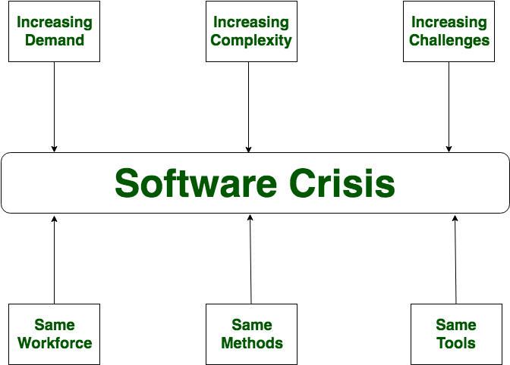
Software Engineering & Testing
Unit 01 :
1) What is Software crisis?

Slide 4
Software Engineering & Testing
Unit 01 :
1) What is Software myths?
myths are false beliefs or interpretations which creates major problems for management and technical people.

Slide 5
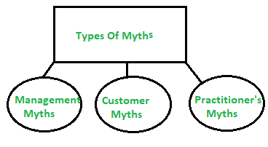
Software Engineering & Testing
Unit 01 :
1) What is Software myths?
- Types of myths

Slide 6
Software Engineering & Testing
Unit 01 :
1) What is Software myths?
- Types of myths:
Management myths:
i)We have all the standards and procedures available for software development.
Facts: Experts do not know all the requirements for the software development.
ii) The addition of the latest hardware programs will improve the software development.
Facts: The role of the latest hardware is not very high on standard software development but rather that hardware may be misused.

Slide 7
Software Engineering & Testing
Unit 01 :
1) What is Software myths?
- Types of myths:
Management myths:
iii) With the addition of more people and program planners to Software development can help meet project deadlines or completion or release.
Facts: Adding more people will merely make the problem worse, because educating and training session the newcomers.

Slide 8
Software Engineering & Testing
Unit 01 :
1) What is Software myths?
- Types of myths:
Customer myths:
Customer has myths leading to false expectations & that’s why you create dissatisfaction with the software developer.
i) A general statement of intent is enough to start writing plans (software development) and details of objectives can be done over time.
Facts: Official and detailed description of the database function are important.

Slide 9
Software Engineering & Testing
Unit 01 :
1) What is Software myths?
- Types of myths:
Customer myths:
ii) Software requirements continually change, but change can be easily accommodated because software is flexible
Facts: Impact of change varies with the time. At early (before design or code has been started), the cost impact is relatively small but grows with respect to time passes

Slide 10
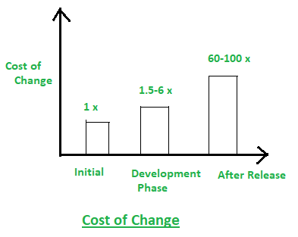
Software Engineering & Testing
Unit 01 :
1) What is Software myths?
- Types of myths:
Customer myths:

Slide 11
Software Engineering & Testing
Unit 01 :
1) What is Software myths?
- Types of myths:
3) Practitioner’s Myths:
i)They believe that their work has been completed with the writing of the plan.
Facts: It is true up to every 60-70 %.
ii) There is no other way to achieve software quality, until it is “running”.
Facts: Not true all the time.

Slide 12
Software Engineering & Testing
Unit 01 :
1) What is Software myths?
- Types of myths:
3) Practitioner’s Myths:
iii) An operating system is the only product that can be successfully exported project.
Facts: Along with this right document brochures and booklets are also required to provide guidance & software support.
iv) Engineering software will enable us to build powerful and unnecessary document & always delay us.
Facts : But rather better quality leads to reduced rework. And reduced rework results in faster delivery times.

Slide 13
Software Engineering & Testing
Unit 01 :
2) Software process & Development:
Software process: As a Framework for the tasks that are required to build high-quality software. But in fact technical methods and automated tools .

Slide 14
Software Engineering & Testing
Unit 01 :
2) Software process & Development:
Software process: A structured set of activities required to develop a software system.
OR
As a Framework for the tasks that are required to build high-quality software. But in fact technical methods and automated tools .

Slide 15
Software Engineering & Testing
Unit 01 :
2) Software process Framework:
Software Process Framework is an abstraction of the software development process. It details the steps and chronological order of a process.
Software process includes:
Tasks – focus on a small, specific objective.
Action – set of tasks that produce a major work product.
Activities – group of related tasks and actions for a major objective.

Slide 16
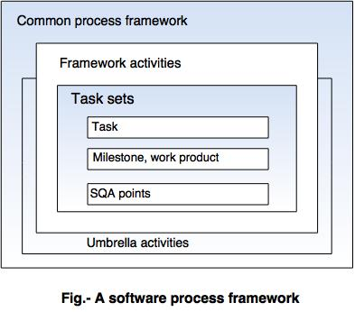
Software Engineering & Testing
Unit 01 :

Slide 17
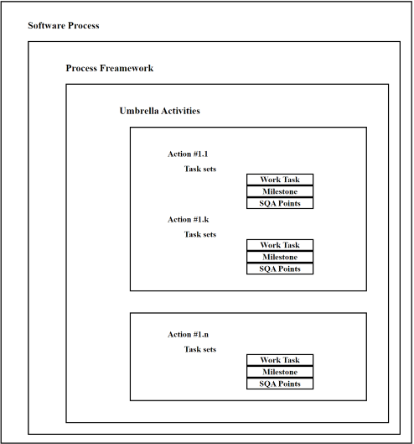
Software Engineering & Testing
Unit 01 :

Slide 18
Software Engineering & Testing
Unit 01 :
Software process Framework:
1) The process of framework defines a small set of activities that are applicable to all types of projects.
2) The software process framework is a collection of task sets.
3) Task sets consist of a collection of small work tasks, project milestones, work productivity and software quality assurance points.

Slide 19
Software Engineering & Testing
Unit 01 :
Basic Umbrella activities are
1. Software project tracking and controlling this activity, the developing team accesses project plan and compares it with the predefined schedule.
2. Risk management Risk is an event that may or may not occur. If the event occurs, then it causes some unwanted outcome. Hence, proper risk management is required.

Slide 20
Software Engineering & Testing
Unit 01 :
Basic Umbrella activities are :
3. Software Quality Assurance (SQA): SQA is the planned and systematic pattern of activities which are required to give a guarantee of software quality.
4. Formal Technical Reviews (FTR): FTR is a meeting conducted by the technical staff.
The motive of the meeting is to detect quality problems and suggest improvements.
The technical person focuses on the quality of the software from the customer point of view.

Slide 21
Software Engineering & Testing
Unit 01 :
Basic Umbrella activities are:
5) Measurement:
-The software cannot be measured directly. It is measured by direct and indirect measures.
a) Direct measures like cost, lines of code, size of s/w.
b) Indirect measures such as quality of software which is measured by some other factor. Hence, it is an indirect measure of software.
6) Software Configuration Management :
It manages the effect of change throughout the software process.

Slide 22
Software Engineering & Testing
Unit 01 :
Basic Umbrella activities are:
7. Reusability management:
It defines the criteria for reuse the product.
The quality of software is good when the components of the software are developed for certain application and are useful for developing other applications.
8. Work product preparation and production: It consists of the activities that are needed to create the documents, forms, lists, logs and user manuals for developing a software.

Slide 23
Software Engineering & Testing
Unit 01 :
Generic View of Software Engineering:
These can be categorized into three generic phases as follows,
01. Definition Phase:
02. Development Phase:
03. Support Phase:

Slide 24
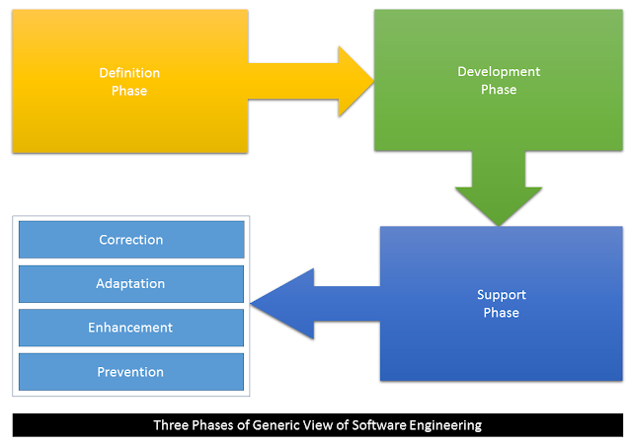
Software Engineering & Testing
Unit 01 :
Generic View of Software Engineering

Slide 25
Software Engineering & Testing Unit -01
1) Definition Phase
The definition phase focuses on “What”.
Means
-what Information needed for processing.
-What functions are required.
-what Expectations about the capacity.
-Interface which is established.
-what Area of the validation.
During this, three major tasks will performed:
System or information engineering.
Software project planning
Requirements analysis.

Slide 26
Software Engineering & Testing Unit-01
02. Development Phase:
The development phase focuses on “How”.
Means
-How data are to be structured.
How function is to be implemented within a s/w architecture,.
How interfaces are to be characterized, how the design will be translated into a programming language.
How testing will be performed.
During this, three major tasks will performed-
1)Software design 2) Code generation, 3)software testing.

Slide 27
Software Engineering & Testing Unit -01
03. Support Phase:
The support phase focuses on “Change”
-Associated with error correction,
-Adaptations required as the software’s environment evolves,
Changes due to enhancements in changing customer requirements.
Four types of change are encountered during the support phase:
1) Correction
2) Adaptation
3) Enhancement
4) Prevention

Slide 28
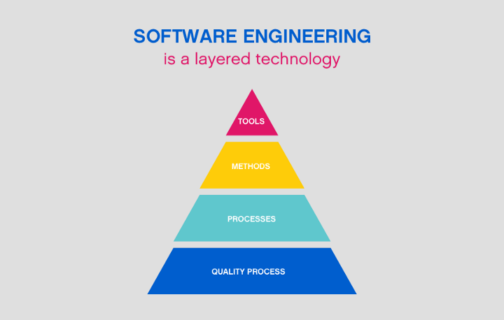
Software Engineering & Testing Unit - 01

Slide 29
Software Engineering & Testing Unit - 01
Tools: This layer contains automated or semi-automated tools that offer support for the framework and the method each software engineering project will follow.
2) Method: This layer contains the methods, the technical knowledge and “how-tos” in order to develop software.
3) Process: This layer consists of the framework that must be established for the effective delivery of software.

Slide 30
Software Engineering & Testing Unit - 01
4)A Quality Focus:
This layer is the fundamental layer for software engineering. Focuses to test the end product to see if it meets its specifications.
Efficiency, usability, maintenance and reusability are some of the elements to be met by new software.

Slide 31
Software Engineering & Testing Unit - 01
The SEI (Software Engineering Institute )
- To determine an organization’s current state of process maturity, the SEI uses an assessment that results in a five point grading scheme. The grading scheme determines compliance with a capability maturity model (CMM)
SEI developed ﬁve process maturity levels that are deﬁned in the following manner,
1)Initial
2) Repeatable
3) Defined
4) Managed
5) Optimizing

Slide 32
Software Engineering & Testing Unit - 01
The SEI (Software Engineering Institute )
1)Initial-
The software process is characterized as inconsistent, and occasionally even chaotic. Success of the organization majorly depends on an individual effort, talent, and heroics.
2) Repeatable - This level of Software Development Organization has a basic and consistent project management processes to track cost, schedule, and functionality.

Slide 33
Software Engineering & Testing Unit - 01
The SEI (Software Engineering Institute )
3) Defined - The software process for both management and engineering activities are documented, standardized.
4) Managed - Management can effectively control the software development effort using precise measurements. At this level, organization set a quantitative quality goal for both software process and software maintenance.
5) Optimizing - The Key characteristic of this level is focusing on continually improving process performance through both incremental and innovative technological improvement

Slide 34
Software Engineering & Testing Unit - 01
What is Software Development Life Cycle?
-SDLC is a systematic process for building software that ensures the quality and correctness of the software built.
-SDLC consists of a detailed plan which explains how to plan, build, and maintain specific software.
-SDLC provides a framework for a standard set of activities & deliverables.
-SDLC defines a methodology for improving the quality of software and the overall development process.

Slide 35
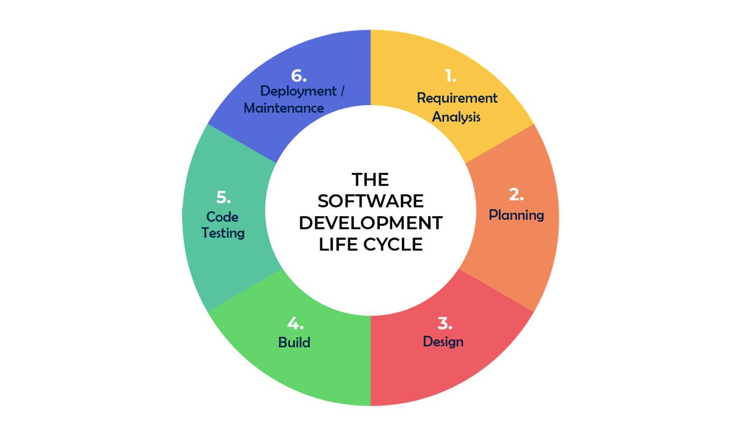
Software Engineering & Testing Unit - 01
Software Development Life Cycle

Slide 36
Software Engineering & Testing Unit - 01
Software Development Life Cycle
SDLC Models-
The Linear Sequential Model or Water fall model -
- Sometimes called the classic life cycle or waterfall model.
a systematic, sequential approach to software development.

Slide 37
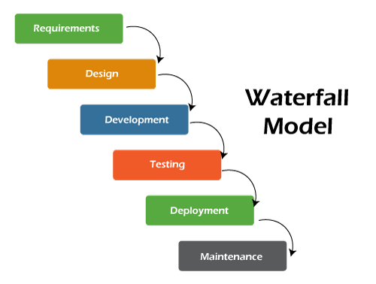
Software Engineering & Testing Unit - 01
Software Development Life Cycle
SDLC Models-
The Linear Sequential Model or Water fall model

Slide 38
Software Engineering & Testing Unit - 01
Software Development Life Cycle
SDLC Models-
Prototyping Model –
- Some time customer does not identify detailed I/O and Developer not sure about algorithm/machine/ Operating System. In such case will select this model.
- In this model prototype is built, tested, and reworked until an acceptable prototype is achieved.
- It is an iterative, trial and error method which takes place between developer and client.
-This model refers to the functionality of the product under development, but may not actually hold the exact logic of the original software.
-

Slide 39
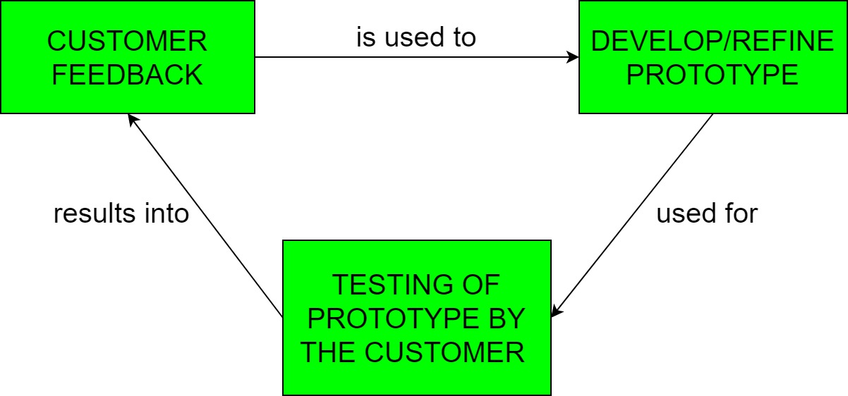
Software Engineering & Testing Unit - 01
Software Development Life Cycle
SDLC Models-
Prototyping Model –

Slide 40
Software Engineering & Testing Unit - 01
Software Development Life Cycle
SDLC Models-
RAD model-
Rapid application development (RAD)is an incremental software development process model that emphasizes an extremely short development cycle.
If requirements are well understood and project scope is constrained, the RAD model create a “fully functional system” within very short time periods .
Primarily used for information systems applications, the RAD approach consists of the following phases-

Slide 41
Software Engineering & Testing Unit - 01
Software Development Life Cycle
SDLC Models-
RAD model-
RAD approach consists of the following phases-
1)Business model
2) Data model
3) Process modelling
4) Application generation
5) Testing and turnover

Slide 42
Software Engineering & Testing Unit - 01
Software Development Life Cycle
SDLC Models-
RAD model-
1)Business modelling - How information ﬂow among business model by asking question
What information is generated?
Who generates it?
Where does the information go?
Who processes it?
2) Data modelling- In this actual information ﬂow of each object are identiﬁed and the relationships between these objects deﬁned.

Slide 43
Software Engineering & Testing Unit - 01
Software Development Life Cycle
SDLC Models-
RAD model-
3)Process modelling-Deals with necessary info. flow.
This model defines implementation of a business function like adding, modifying, deleting, or retrieving a data object.
4) Application generation- It works to reuse existing program components by using automated tools.
5) Testing and turnover- RAD emphasizes reuse, so many of the components have already been tested but however, new components must be tested.

Slide 44
Software Engineering & Testing Unit - 01
Software Development Life Cycle
SDLC Models-
Evolutionary Software Process Models-
1) The Incremental Model
2) The Spiral Model
3) Concurrent Development Model

Slide 45
Software Engineering & Testing Unit - 01
Software Development Life Cycle
SDLC Models-
Evolutionary Software Process Models-
- In Evolutionary models are iterative in nature.
-
This model is a combination of incremental and iterative models.
In the evolutionary model, all work divided into smaller chunks.

Slide 46
Software Engineering & Testing Unit - 01
Software Development Life Cycle
SDLC Models- The Incremental Model
-The incremental model combines elements of the linear sequential model (applied repetitively) with the iterative techniques of prototyping.
- First, a simple working system implementing only a few basic features is built and then that is delivered to the customer. After that many successive iterations/ versions are implemented and delivered to the customer until the desired system is released.

Slide 47
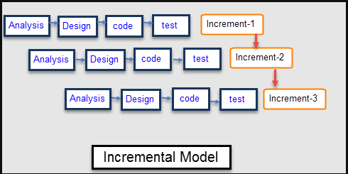
Software Engineering & Testing Unit - 01
Software Development Life Cycle
SDLC Models- The Incremental Model –

Slide 48
Software Engineering & Testing Unit - 01
Software Development Life Cycle
SDLC Models-
2) The Spiral Model –
- This Spiral model is a combination of iterative development process model and sequential linear development model.
Specific activities performed in one iteration (spiral) where the output is a small prototype of the large software.
The same activities are then repeated for all the spirals until the entire software is built
- This model is best used for large projects which involve continuous enhancements.

Slide 49
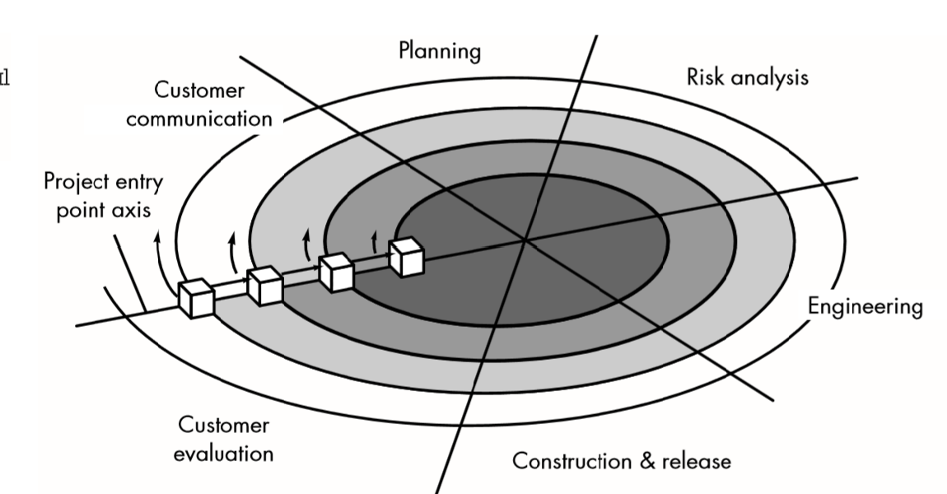
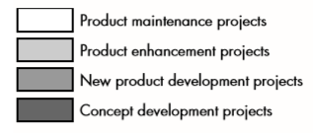

Software Engineering & Testing Unit - 01
Software Development Life Cycle
SDLC Models- 2) The Spiral Model –

